Slide 1

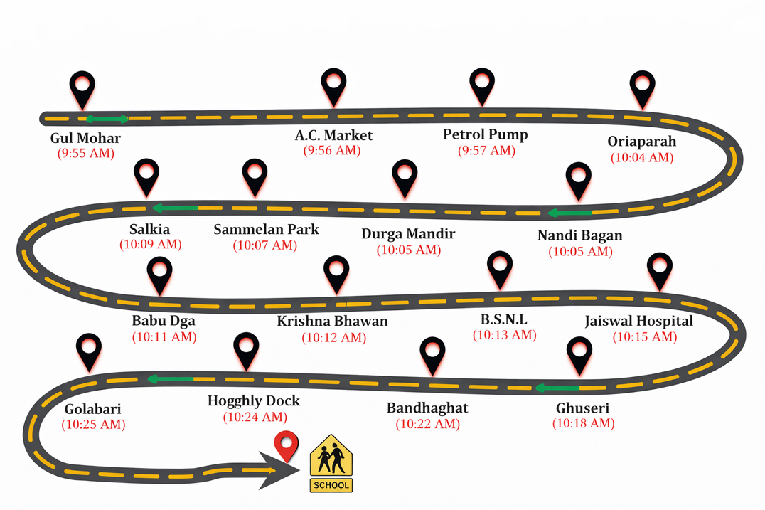
Probability model to solve the school bus routing problem with stops selection
Made by:
Saumya Shah(AU2440274) &
Pratyusha Sharma (AU2440012)

Slide 2

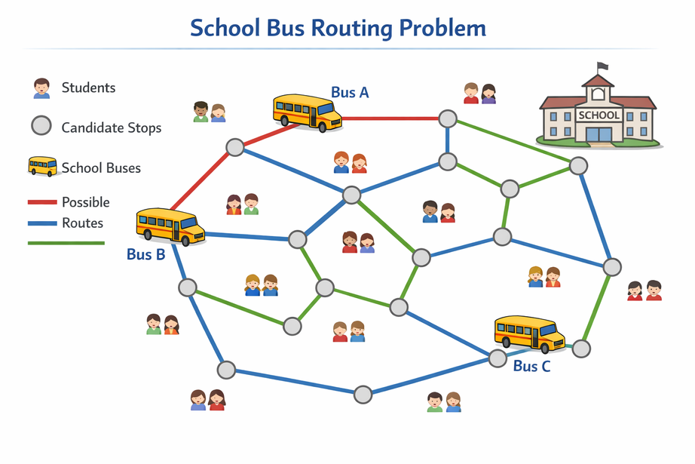
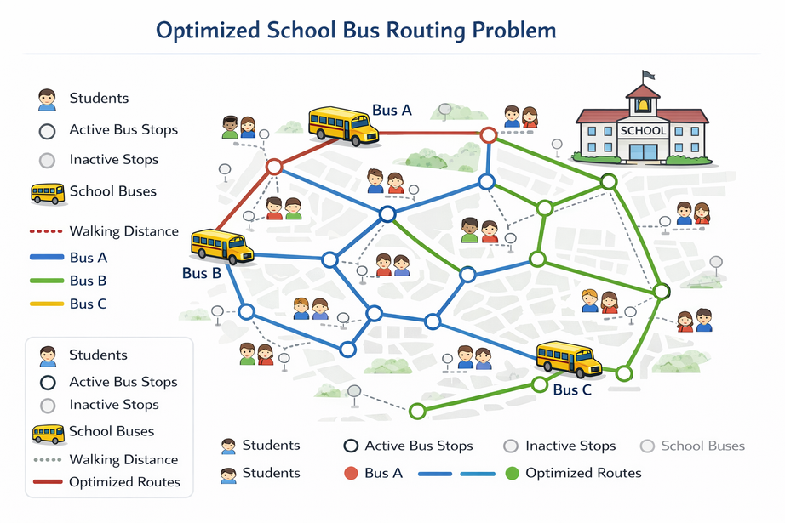

Project Context and Motivation
Application Domain: Intelligent Transportation System (ITS) [school bus - routing]
Real-World Context: Student transport with changing stops and constrsints
Reason for uncertainty: Combinational routing choices and interacting constraints
| ‹#›

Slide 3
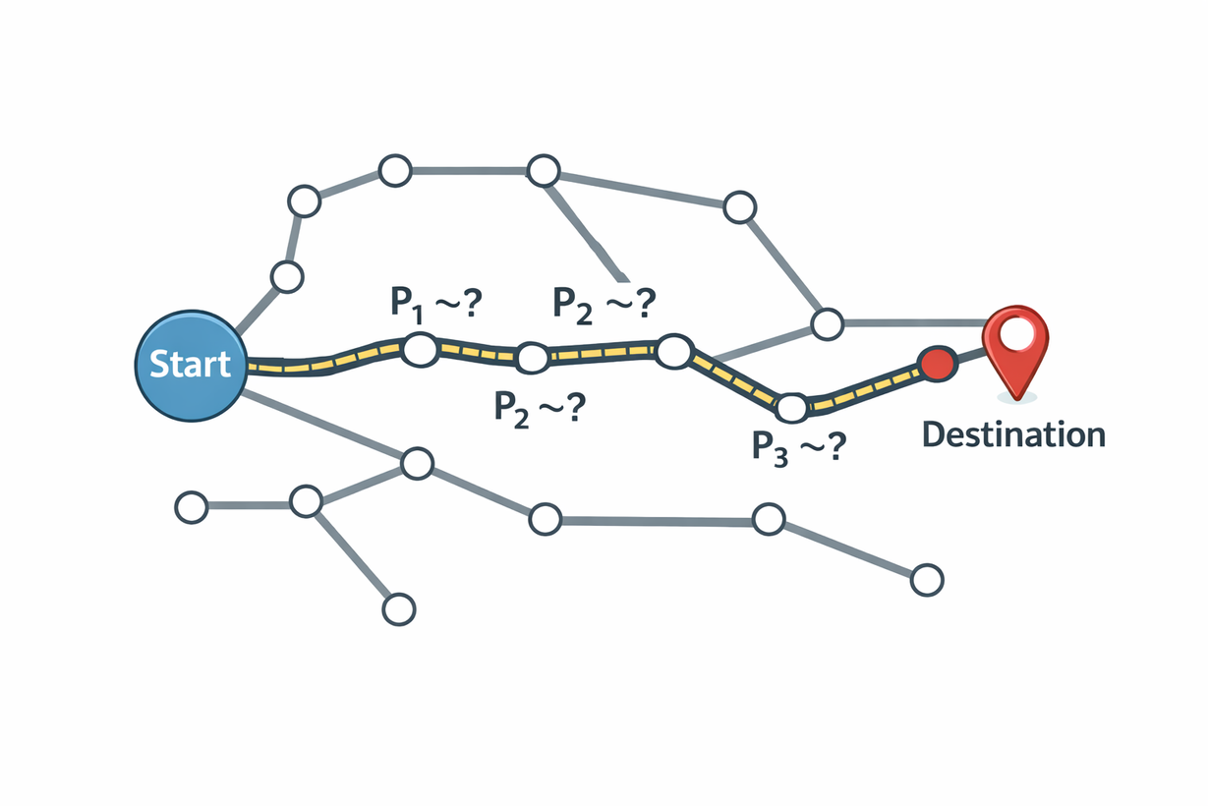
Project Objective and Scope
Exact Objective:
Minimize expected travel time ofall school buses
Decision Task:
Select stops, asign students and sequence routes
Scope:
Static probabilistic road network
| ‹#›

Slide 4
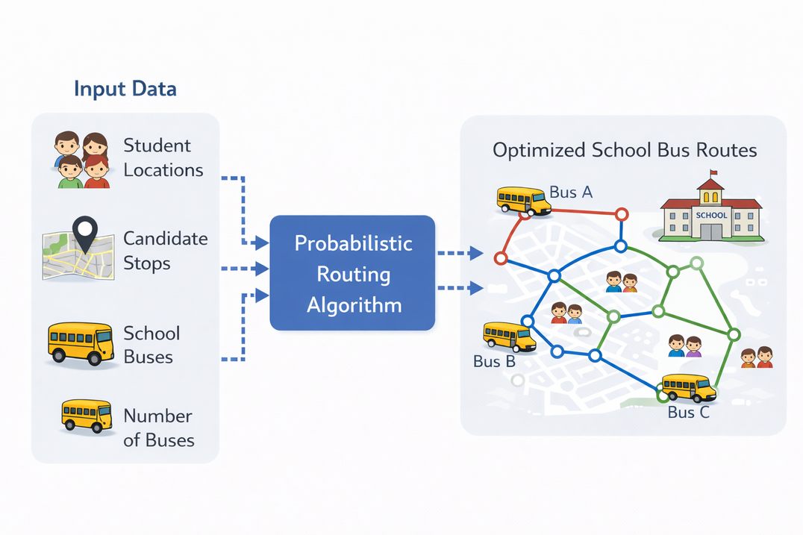
Project System Overview
Pipeline:
Components: Student-stop assignment,EDA- based routing
Data Flow: Fitness guides probability updates
Input data
Allocation
probabilistic routing
Evaluation
Probability Modeling
Sampling
| ‹#›

Slide 5
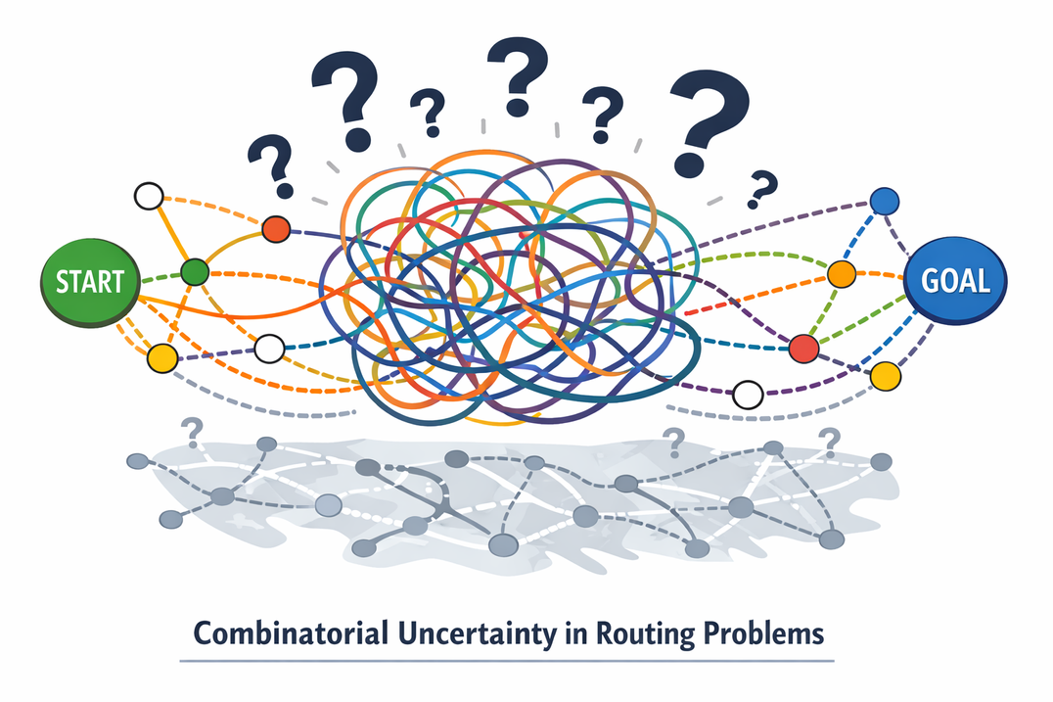
Source of Uncertainty in the Project
Measurement Uncertainty: Approximate student and stop locations
Contextual Variability: Changing student distributions and constraints
Modeling Uncertainty: Multiple valid route permutations
| ‹#›

Slide 6
Key Random Variables and Their Roles
Primary Random variable: Positions of bus stops in route permutations
Representation: Probability of assigning a stop toa route problem
| ‹#›

Slide 7
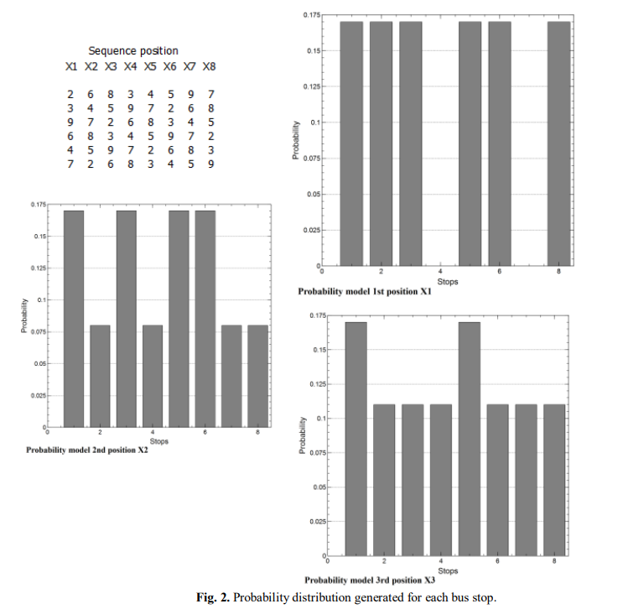
Probabilistic Models and Assumptions
Model used: Estimation of Distribution Algorithm
Assumption: Independence between route positions
Justification: Combinational routing choices and interacting constraints
| ‹#›

Slide 8
Probabilistic Reasoning and Inference Logic
Uncertainty Propagation
Large combinations of stop selections and route permutations create combinatorial uncertainty.
Student allocation and capacity constraints affect feasibility, while probability distributions progressively reduce uncertainty across generations.
Role of Probabilistic Reasoning:
Estimate marginal probability distributions from elite solutions to capture patterns of high-quality routes.
Use these learned distributions to guide probabilistic sampling and iteratively improve solution quality.
Conceptual Reasoning Pathway:
travel time of each route as a random quantity
calculate average travel time and variability
finding chance of delay beyond a given limit
choosing the route with lower uncertainty and reasonable travel time
Compare routes based on speed and reliability
| ‹#›

Slide 9
Operationalizing Probabilistic Reasoning
Slide 7 Reasoning
Learn marginal probability distributions from elite routes.
Generate improved routes through probabilistic sampling and iteration.
Evaluation Metrics & Probabilistic Interpretation
Minimize total travel time as fitness measure.
Population statistics reflect learned route structure.
Simplifying Assumptions
Independence between route positions.
Fixed capacity and walking distance.
| ‹#›

Slide 10
Current Limitations and Gaps
Known Weakness
• Independence assumption may ignore dependencies between stop positions.
• Performance may decline for very large-scale instances.
Unverified / Questionable Assumptions
• Travel times treated as deterministic (no traffic uncertainty).
• Student allocation fixed before routing optimization.
Conceptual Ambiguities
• Interaction between stop selection and routing not fully modeled jointly.
• Effect of population size and parameters on convergence not deeply analyzed.
| ‹#›

Slide 11
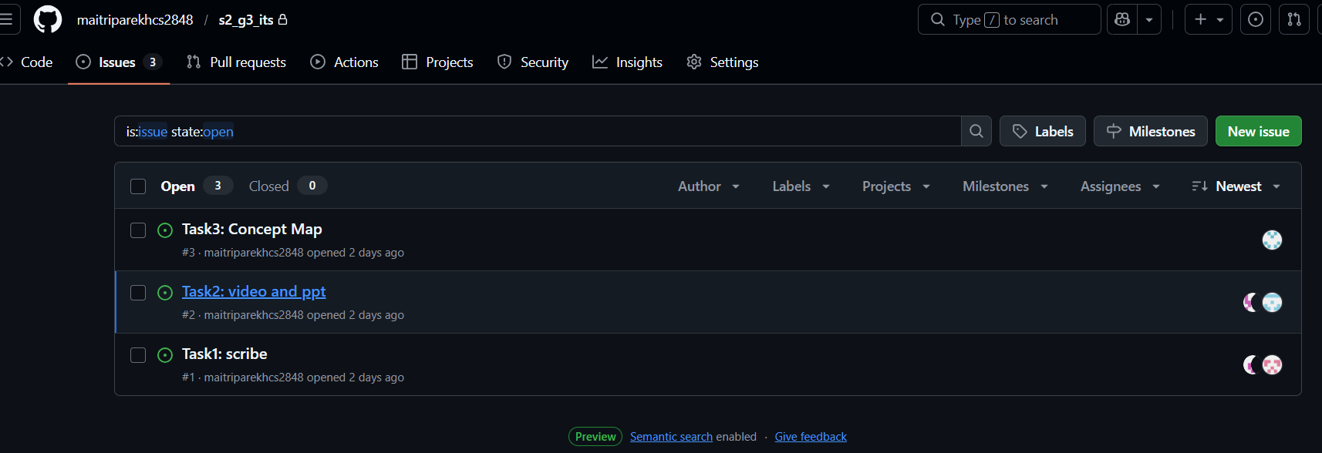
Planned Refinements and Role Coordination
What Will Evolve in the Next Milestone?
• Improve probability model and experiment with parameter tuning.
• Expand testing and refine route optimization performance.
Conceptual / Modeling Tasks Ahead
• Explore modeling dependencies between route positions.
• Analyze scalability and convergence behavior.
Role of Reviewer / GitHub Manager
• Create repository and add team members as collaborators.
• Assign issues, review contributions, and approve pull requests.
| ‹#›

Slide 12
Summary of Group-Level Understanding
• The routing problem is modeled as a probability distribution over feasible route permutations.
• Estimation of Distribution Algorithm (EDA) learns structural patterns from elite solutions instead of using random evolutionary operators.
• Marginal probability distributions guide solution generation and progressively reduce uncertainty.
• Probabilistic modeling enables systematic exploration of a large combinatorial search space.
| ‹#›

Slide 13
Reference
Pérez-Rodríguez, R., & Hernández-Aguirre, A. (2016). Probability model to solve the school bus routing problem with stops selection. International Journal of Combinatorial Optimization Problems and Informatics, 7(1), 30-39
| ‹#›

